Slide 1
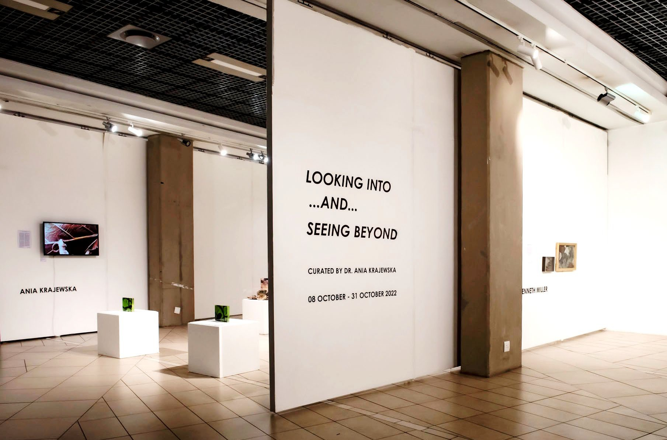
Looking into… and Seeing beyond
UNISA STAFF EXHIBITION
08 – 31 October 2022

Slide 2
ANIA KRAJEWSKA
PLANTS HAVE POEMS INSIDE THEM

Slide 3


Slide 4
Being an attentive, keen, and tender observer of leaves and their life processes was the key drive behind this project. Leaves not only tell us their stories of the unstoppable transience states but connect us to the living world. Their breath-outs are our breath- ins forming a continuous harmony between the interiority of multitudes of chloroplasts tightly packed under their epidermis and their bond to the vastness of the outer space and the energy of our closest star. As the poet, Maria Pawlikowska Jasnorzewska (1891-1945) said, plants can be our role models for leading congruous and worth-while lives: "This group of entities taking from life what is good: peace, quiet and clear conscience. In harmony next to each other, they heal us with their example of undisturbed peace. The forest is more than a wood-sap treasure to our breath, a pitchy balsam for our tired lungs or a green kaleidoscope for our eyes.“
The questions I raise are environmentally ethical in the sense that Antonio Damasio (2003:171), the behavioural biologist and neuroscientist, claims Spinoza adumbrated,
The biological reality of self preservation leads to virtue because in our inalienable need to maintain ourselves, we must, of necessity, help preserve other selves. If we fail to do so we perish and are thus violating the foundational principle and relinquishing the virtue that lies in self- preservation. The secondary foundation of virtue is the reality of a social structure and the presence of other living organisms in a complex system of interdependence with our own organism. We are in a bind, literally, in the good sense of the word…
Spinoza ties it to a biological principle - the mandate for self preservation ... the foundation for a system of ethical behaviours and that foundation is neurobiological.
In other words, engaging with preservation and paying deep attention to our biological environments is crucial for our own self-preservation. However, while the ethical and mindful living is pivotal to the Plants have Poems inside them, the work is also driven by the re enchantment with the "in betweenness" and transience of all life forms. Looking at leaves close and anew, devotedly photo-documenting different stages of their being and paying attention to the entities usually taken for granted, can bring about a contemplation on our own brevity.
That the present atmosphere is rich in oxygen is the result of 2.7 billion of years of photosynthetic processes initiated by the first unicellular organisms like cyanobacteria, which unfailingly kept releasing oxygen into the Earth's gases as a by-product of transforming carbon dioxide and sunlight into energy (Lane 2003). And artists like Joe Davis unfold the drama of these life-giving photosynthetic processes and pay tribute to "lower" life forms in RuBisCo Stars (2009) whereby sending chemical formulae of chloroplast enzymes19 (1) essential for photosynthesis as radio signals into the cosmos to be the ambassadors of life on our planet, attest to the non human part of ecology.
(1) Full name: Protein Ribulose - 1,5-bisphosphate Carboxylase Oxygenase. The Foundation of all life on Earth.
https://www.aniakrajewska.com

Slide 5
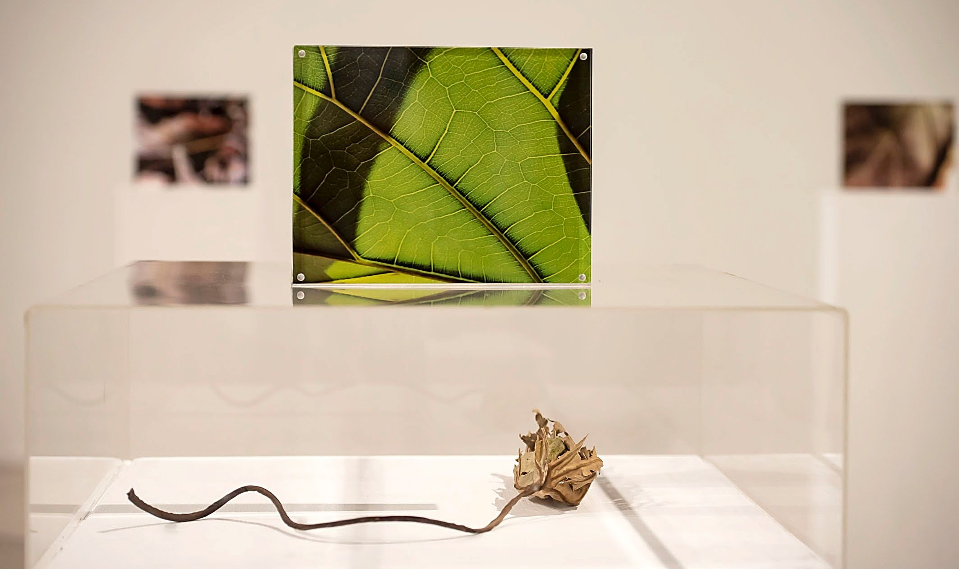

Slide 6
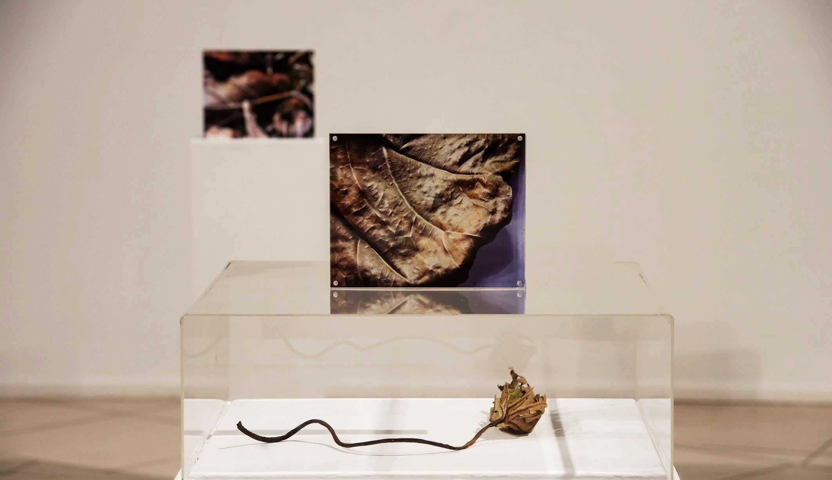

Slide 7
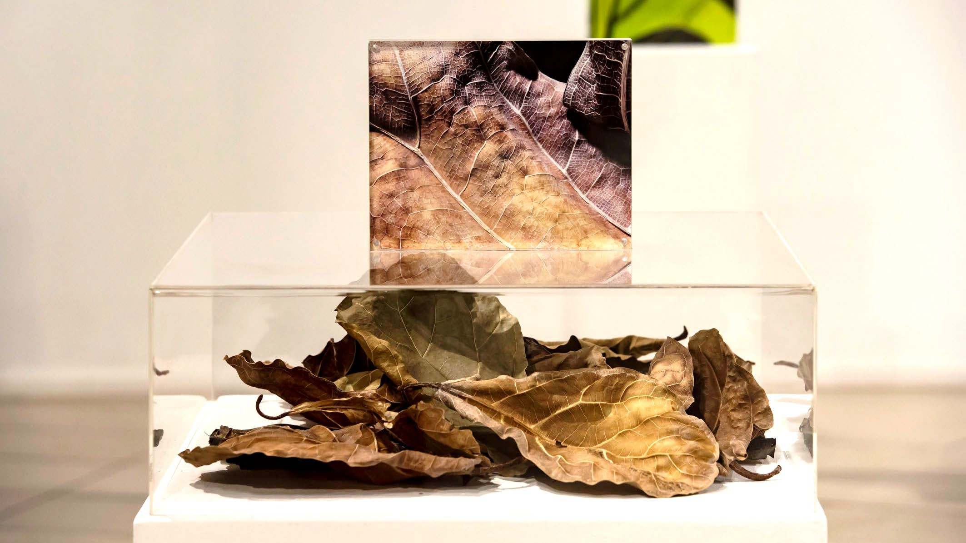

Slide 8
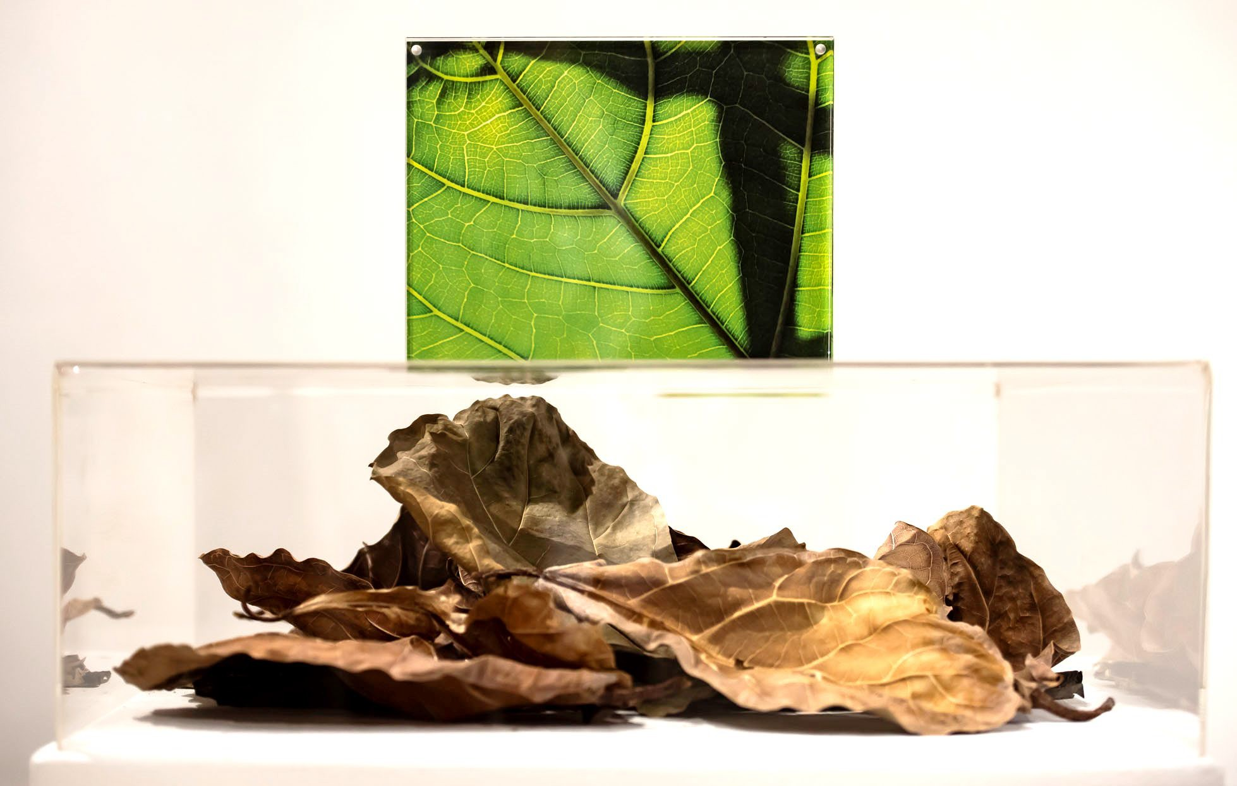

Slide 9
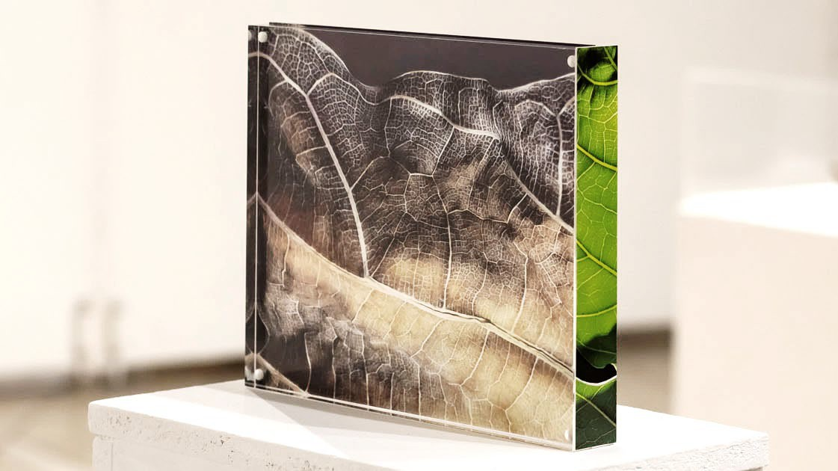

Slide 10
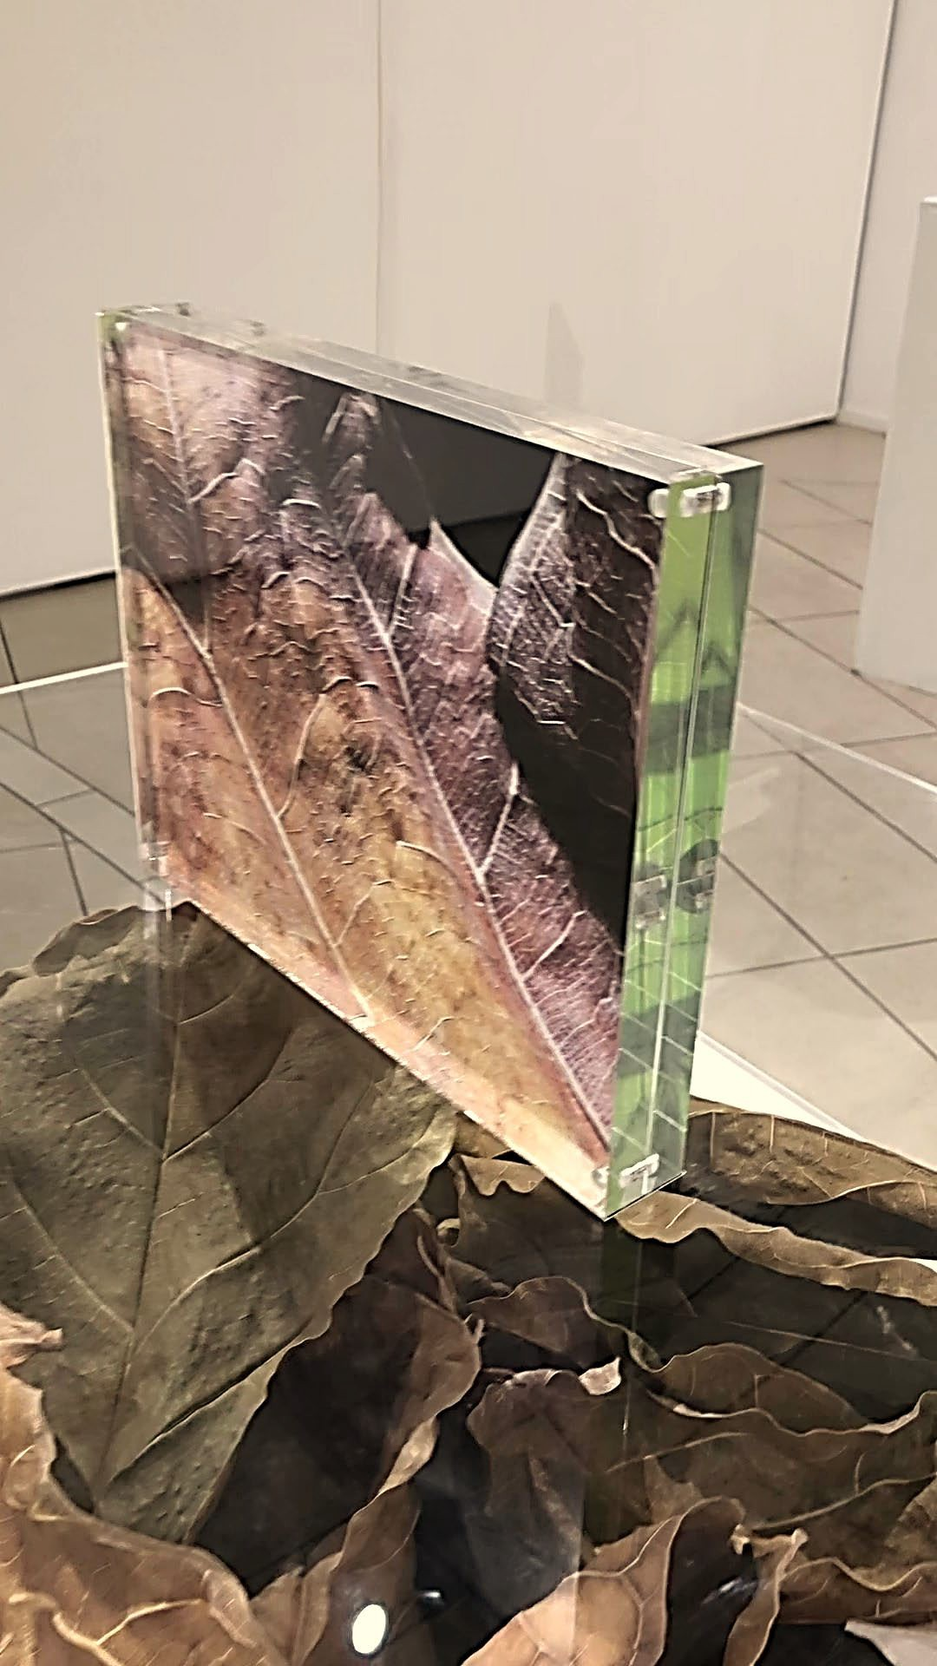
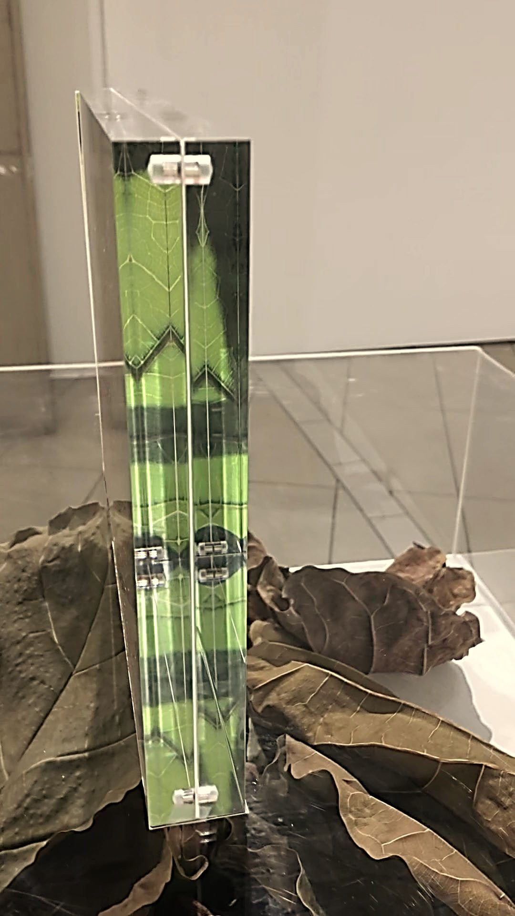
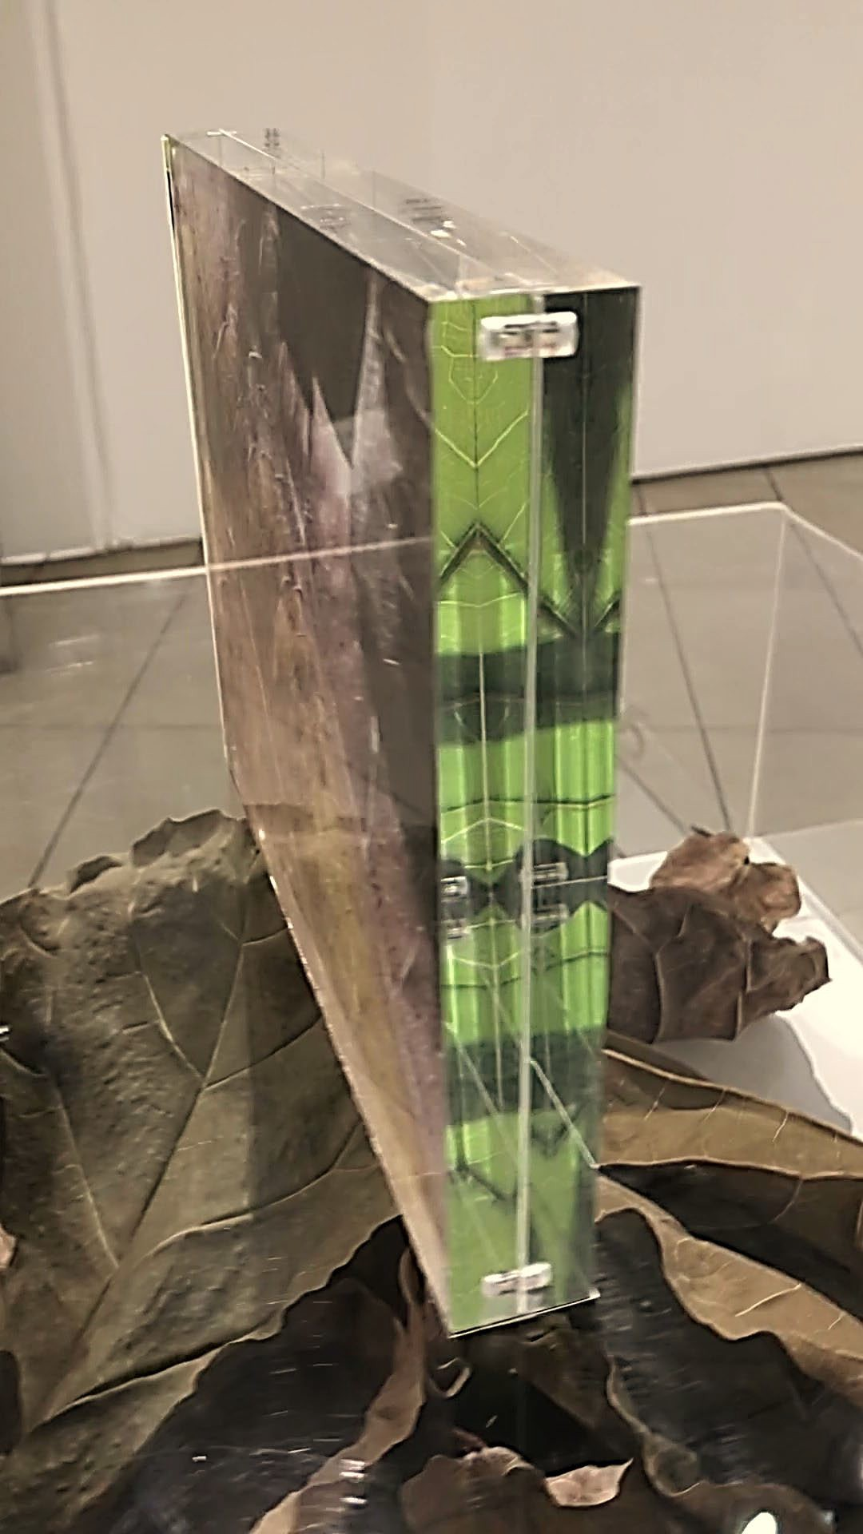

Slide 11
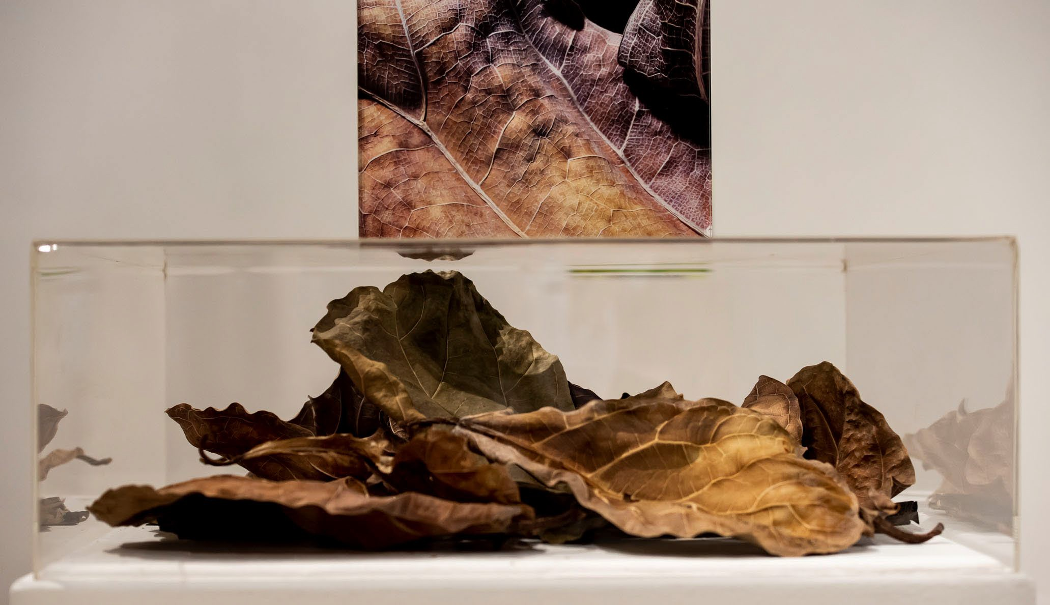

Slide 12
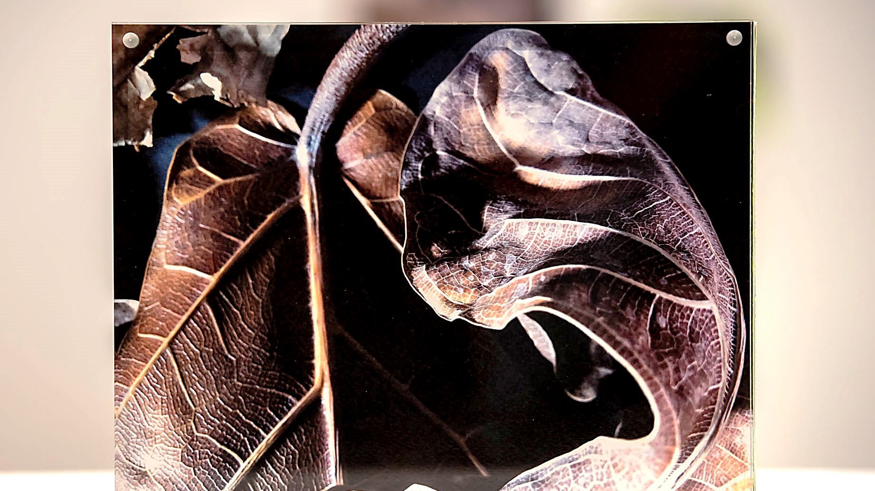

Slide 13
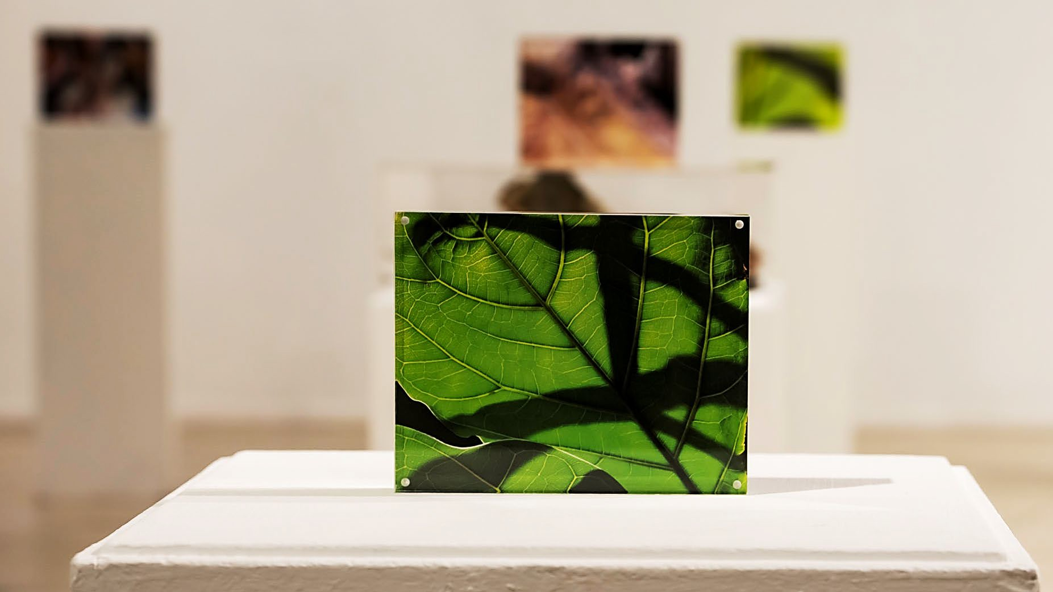

Slide 14
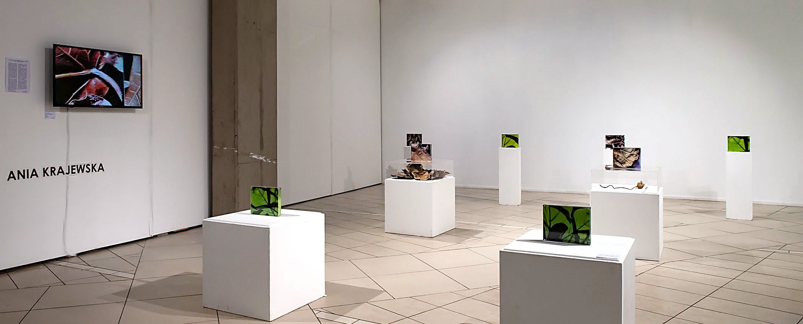

Slide 15
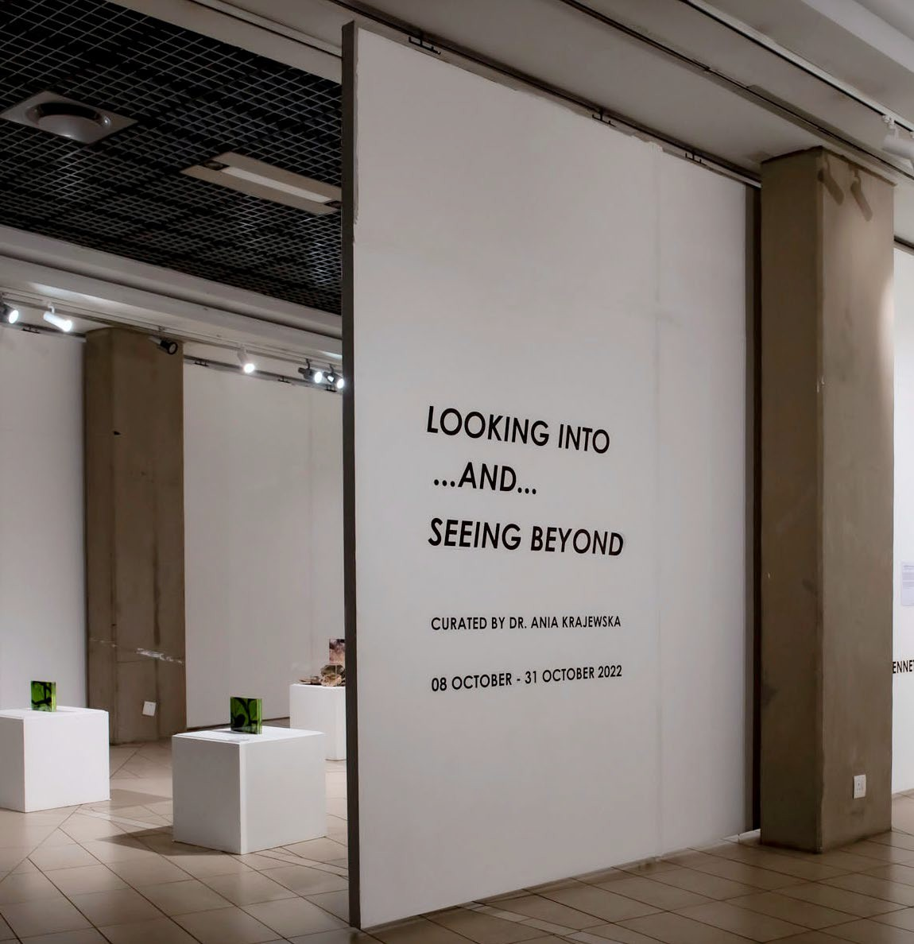
Looking into… and Seeing beyond
UNISA STAFF EXHIBITION
08 – 31 October 2022

